Slide 1

EDMONTON RACE PREVIEW
Elite Analysis · July 15 – 19, 2026
USA Triathlon High Performance

Slide 2
Race Week Schedule
Edmonton
July 15 – 19, 2026 • William Hawrelak Park, 9330 Groat Rd NW, Edmonton, AB (MDT, UTC-6)
Wed-Thu • July 15-16
Fri • July 17
Sat • July 18
Sun • July 19
Open Swim Training
Familiarization & Briefing
ELITE SPRINT RACE DAY
Mixed Relay Day
10:30 – 12:30 | Swim Training — Kinsmen Sport Centre (Wed)
18:00 – 20:00 | Swim Training — Kinsmen Sport Centre (Wed)
11:45 – 13:45 | Swim Training — Kinsmen Sport Centre (Thu)
18:00 – 20:00 | Swim Training — Kinsmen Sport Centre (Thu)
7:45 – 9:45 | Swim Training — Kinsmen Sport Centre
13:00 – 14:00 | Bike Familiarization — Hawrelak Park (police-escorted)
14:00 – 15:00 | Swim Familiarization — Hawrelak Park lake
16:00 – 16:45 | ★ Elite & Mixed Relay Athletes' Briefing — Heritage Amphitheatre
16:45 – 17:15 | Elite Race Package Distribution — Heritage Amphitheatre
12:30 – 13:30 | Elite Athlete Lounge open — Men
13:00 – 13:45 | Transition check-in + swim warm-up — Men
13:50 – 13:58 | Elite Men introductions
14:00 | ★ ELITE MEN — SPRINT TRIATHLON START
15:15 | Elite Men medals ceremony
14:30 – 15:30 | Elite Athlete Lounge open — Women
15:00 – 15:45 | Transition check-in + swim warm-up — Women
15:30 | Mixed Relay — online team declaration
15:50 – 15:58 | Elite Women introductions
16:00 | ★ ELITE WOMEN — SPRINT TRIATHLON START
17:15 | Elite Women medals ceremony
17:30 – 18:00 | Mixed Relay — team declaration (Athletes' Lounge)
12:30 – 12:45 | Mixed Relay final team declaration
13:00 – 14:00 | Elite Mixed Relay athlete lounge open
13:30 – 14:15 | Transition check-in + swim warm-up
14:20 – 14:28 | Mixed Relay team introductions
14:30 | ★ ELITE MIXED RELAY START
16:00 | Elite Mixed Relay medals ceremony
Times William Hawrelak Park, 9330 Groat Rd NW, Edmonton, AB (MDT, UTC-6). Schedule confirmed from World Triathlon race-info page / athlete guide; subject to organiser updates.

Slide 3
Key Course Differentiators
Edmonton
EDMONTON
COURSE AT A GLANCE
The 2026 World Triathlon Cup Edmonton returns elite racing to William Hawrelak Park, newly renovated ahead of the 2027 World Triathlon Multisport Championships — this race is the first elite test of the rebuilt course. Edmonton has a long elite history at this tier and above: WTS races in 2018 and 2019, and the 2021 World Triathlon Championship Finals, where Kristian Blummenfelt and Flora Duffy clinched world titles on this same lake. The last two editions (2023-24) stepped down to Americas Triathlon Cup level, so this World Cup marks a return to a stronger international field. Format is standard sprint: 750 m lake swim, 20.4 km bike (3 laps, valley climb each lap), 5 km run (3 laps). Elite Men go off at 14:00 and Elite Women at 16:00 on Saturday July 18; Mixed Relay follows Sunday July 19.
Swim:
750 m – 1 lap
Bike:
20.4 km – 3 laps × 6.8 km
Run:
5 km – 3 laps × 1.66 km
Format:
Sprint Triathlon (World Cup)
COURSE FEATURES
Bike Laps:
3
Run Laps:
3
• 750 m Hawrelak Park lake swim — sheltered fresh water, single clockwise loop, ~19 °C (optional wetsuit).
QUICK LINKS
• 20.4 km bike — 3 × 6.8 km laps with a repeated river-valley climb/descent (+85 m/-87 m per lap).
Current Race Info:
Race Info | 2026 World Triathlon Cup Edmonton
• 5 km run — 3 × 1.66 km laps on paved park paths, moderate heat risk (July highs ~23 °C).
• Elite Men 14:00 / Elite Women 16:00, Saturday July 18. Mixed Relay 14:30, Sunday July 19.

Slide 4
Course Profile & Map
Edmonton
[PLACEHOLDER: Insert upcoming course map or race photo here] Right-click → Replace Image, or paste screenshot of the World Triathlon course map PDF.
[PLACEHOLDER: Insert previous year course map or race photo here] Right-click → Replace Image, or paste screenshot of the World Triathlon course map PDF.
2026 Course
2025 Course
Source: [PLACEHOLDER: World Triathlon event page URL]
Source: https://www.triathlon.org/events/event/2024_americas_triathlon_cup_edmonton
Discipline | Distance | Laps | Terrain / Notes
Swim | — | — | [PLACEHOLDER: e.g. Open-water, Bay of Edmonton]
Bike | 20.0 km | 2 | [PLACEHOLDER: e.g. Flat coastal road circuit, closed course]
Run | — | — | [PLACEHOLDER: e.g. Flat multi-lap, cobblestone city-centre finish]

Slide 5
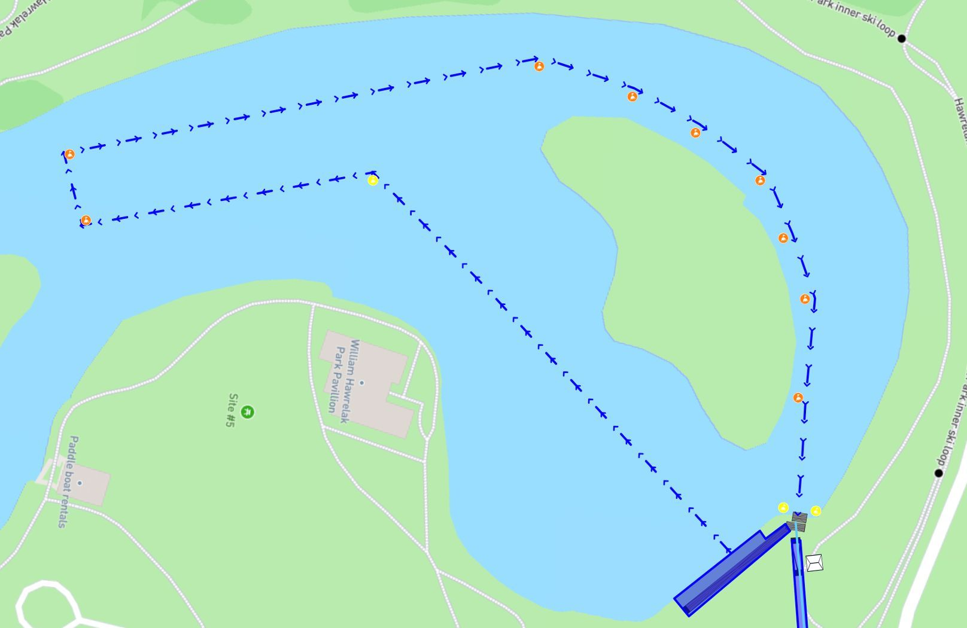
Swim Course Profile
Edmonton
750 m • single lap
Sheltered park lake — fresh water, calm conditions
Distance
Layout
Start
750 m
Hawrelak Park Lake
In-water start off the swim start platform
Water Temp
Wetsuit
Lap Count
19.0 °C
Wetsuit optional (19 °C)
1
Tactical Notes
• Single 750 m clockwise loop on Hawrelak Park's lake — calm, sheltered, no current or chop
• First (yellow) buoy passed on the left shoulder at 200 m; all subsequent orange buoys passed on the right shoulder
• Run to T1 is 220 m from the swim exit — longer transition run than most sprint venues
• Swim familiarization Friday July 17, 14:00-15:00 only — no other in-water access permitted for safety
Source: 2026 World Triathlon Cup Edmonton Athlete Guide v2 (Do North Events) — July 18-19, 2026
• Elite Men warm-up 13:00-13:45, Elite Women warm-up 15:00-15:45 on race day

Slide 6
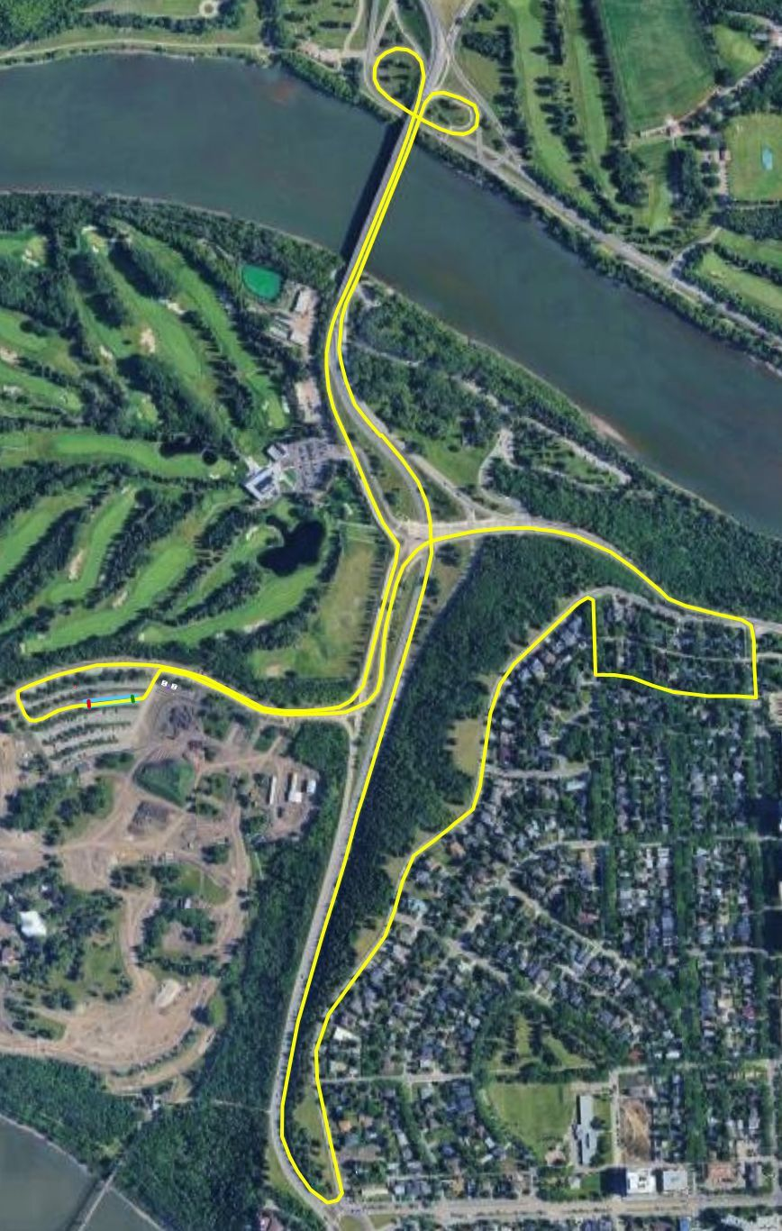
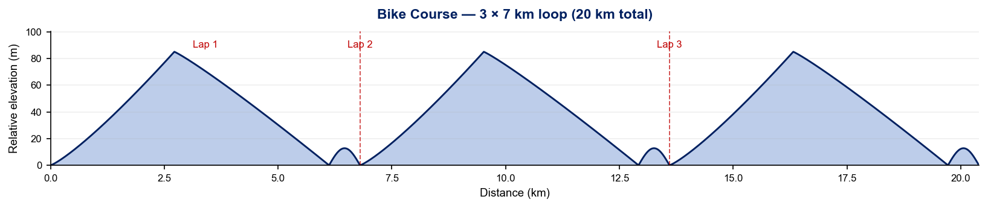
Bike Course Profile
Edmonton
20.4 km • 3 × 6.8 km loops
Closed road circuit — Groat Rd, Saskatchewan Dr NW, William Hawrelak Park Rd
Elevation / Lap
Total Climb
Avg Grade
+85.0 m / 87.0 m
~255 m
—
Max Climb Grade
Wind
Loops
—
River valley setting — generally sheltered, variable on the Saskatchewan Dr exposure
3 × 6.8 km
Tactical Implications
• 3 × 6.8 km laps (20.4 km total) out of Hawrelak Park up Groat Rd and along Saskatchewan Dr NW
Source: 2026 World Triathlon Cup Edmonton Athlete Guide v2 (Do North Events) — July 18-19, 2026
• One sustained climb/descent per lap out of the river valley (+85 m / -87 m per lap per the athlete guide profile) — first true elevation test on this venue since 2021
• Course map lists overall elevation gain as 76.5 m — legs will feel the repeated valley climb across all 3 laps
• Team Wheel station just outside transition (both-side access); Neutral Wheel station at the loop's south end on Saskatchewan Dr, before the right turn back toward the park
• Neutral wheels: 700c front/rear, 11/12-speed, 140/160mm rotor options, 28mm tires at 65/70 psi (front/rear)
• Newly renovated venue ahead of the 2027 World Triathlon Multisport Championships — this is the first elite race on the rebuilt course
Stylised — exact contours from a GPS-recorded race FIT would refine this.

Slide 7
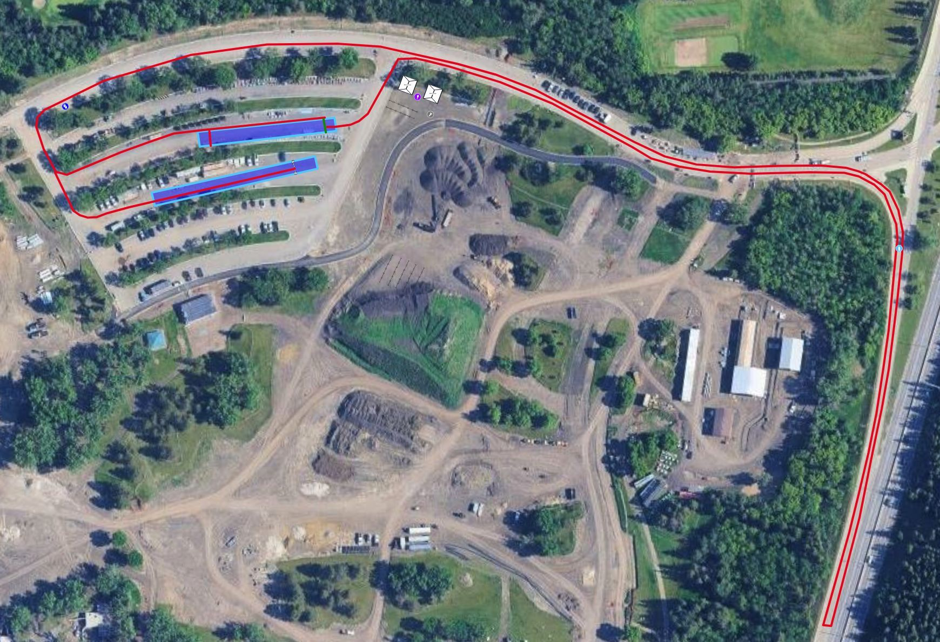
Run Course Profile
Edmonton
5.0 km • 3 × 1.7 km
Paved park paths — loop sits next to the transition area
Distance
Lap Structure
Total Climb
5.0 km
3 × 1.7 km
~51 m
Avg Grade
Max ▲ / ▼
Heat Risk
—
Not published
LOW–MODERATE
Tactical Notes
• 3 × 1.66 km laps (5 km total), counter-clockwise, run next to the transition area by design to avoid a first-runner/last-biker clash
• Aid station passed 6 times total (out and back per lap) — sealed water bottles at 400 m, 850 m, 2000 m, 2450 m, 3600 m, 4050 m, served on the athlete's right
• Littering zones marked green (start) / red (end) at each aid and wheel station — time penalties apply outside them
• Run penalty box on the left side of the road, 200 m before the finish — passed every lap
Source: 2026 World Triathlon Cup Edmonton Athlete Guide v2 (Do North Events) — July 18-19, 2026
• July averages a 23 °C high / 12 °C low with a late sunset (21:32) — moderate heat risk for the 14:00/16:00 Elite starts, well short of Huatulco-level heat stress

Slide 8
Travel & Arrival Load
Denver, CO → Edmonton race week
Core travel read
Denver → Edmonton is a same-zone trip — both cities run Mountain Time (MDT in July), so there is zero jet-lag adjustment. No historical nonstop DEN-YEG service; typical itineraries connect through Calgary (YYC), Vancouver (YVR), or Seattle (SEA) on WestJet, Air Canada, Alaska, or United. LOC-provided shuttles run Wednesday July 15 through Monday July 20 between the airport and the Westin Hotel only — submit arrival/departure details by July 5, 2026 or transportation is not guaranteed. A visitor visa or eTA is required for most nationalities entering Canada; contact Triathlon Canada for a visa support letter.
Primary route
Time zones
Airport Transfer
Venue Transfer
Arrival deadline
DEN → YEG
+0h
YEG → The Westin
Westin → Hawrelak Park
July 5, 2026
1 stop typical (YYC/YVR/SEA)
Both Mountain Time (MDT)
LOC shuttle, ~30 km / 40 min
LOC shuttle, 4.5 km / 7-10 min
Submit itinerary form or fees may apply
Host Hotel / Official Accommodation
Food / Grocery Options Near Hotel + Venue
• Official host hotel: The Westin Edmonton, 10135 100 St NW, Edmonton, AB T5J 0N7 — 4.5 km / 7-10 min from the venue by car or bike.
• Not itemized in the athlete guide — the Westin sits downtown with typical hotel-district dining and grocery access within a few blocks.
• Alternative discounted block: Lister Hall, 11613 87 Ave NW — 2.0 km / 5 min from the venue; book via front desk 780-492-6056, reference "2026 World Triathlon Cup."
• Lister Hall option is on the University of Alberta campus — Whyte Ave (109 St / 82 Ave) strip is a short ride away for groceries and casual dining.
• LOC free shuttle covers Westin ↔ Hawrelak Park for familiarization and race day only — athletes staying elsewhere arrange their own transport.
• Kinsmen Sports Centre (swim training venue) and Hawrelak Park both sit along the river valley bike path connecting the Westin, Lister Hall, and the U of A.
• Underground parking available at the Westin for a fee, managed directly by the hotel.

Slide 9
Environmental Risk Profile
Edmonton
RACE-DAY WEATHER (08:00–11:00 local)
AIR QUALITY (Open-Meteo archive)
Year | Date | Air Temp | Humidity | Wind km/h | Precip mm
2018 | Jul 27 | 17.7°* | 69% | 4 | 0.0
2019 | Jul 20 | 16.0°* | 83% | 10 | 0.0
2021 | Aug 21 | 12.5°* | 80% | 8 | 0.0
2023 | Aug 26 | 20 | 82% | 9 | 0.0
2024 | Aug 24 | 18.2°* | 81% | 20 | 0.1
Year | PM2.5 | EU AQI | UV Index | Risk
2018 | — | — | — | —
2019 | — | — | — | —
2021 | — | — | — | —
2023 | 15.4 | 46 | 1.7 | Moderate
2024 | 12.5 | 31 | 1.3 | Fair
HEALTH & WATER QUALITY RISK FACTORS
• Water Quality: [PLACEHOLDER: Historical water quality data for Edmonton — e.g. bacterial counts, EU Bathing Water Directive status, known algae / pollution events. Check local environmental agency reports for May race window.]
• Athlete Health Incidents: [PLACEHOLDER: Any known GI illness, respiratory, or heat-related incidents at this or comparable venues. E.g. Sunderland 2023 — reported GI illness post-swim for multiple athletes.]
• Water Temperature: [PLACEHOLDER: Historical open-water temperature for Edmonton in May (not available from Open-Meteo; check Copernicus Marine / NOAA or WT historical results).]
• Heat / Humidity Risk: Auto-derived from above table — flag if humidity >70% or air temp >25°C at race time.
Weather and AQ data: Open-Meteo historical archive (archive-api.open-meteo.com). EU AQI: Good ≤20, Fair ≤40, Moderate ≤60, Poor ≤80, Very Poor >80.

Slide 10
Who to Watch — Edmonton Race Week
ELITE MEN
ELITE WOMEN
Top 10 by World Ranking
Top 10 by World Ranking
Rank | Athlete | Points
1 | Vasco Vilaca | 6,866
2 | Miguel Hidalgo | 6,808
3 | Matthew Hauser | 6,424
4 | Henry Graf | 6,009
5 | David Cantero Del Campo | 5,092
6 | Csongor Lehmann | 4,789
7 | Luke Willian | 4,496
8 | Dorian Coninx | 4,467
9 | Ricardo Batista | 4,280
10 | Charles Paquet | 4,128
Rank | Athlete | Points
1 | Beth Potter | 7,347
2 | Lisa Tertsch | 7,136
3 | Leonie Periault | 6,468
4 | Jeanne Lehair | 6,306
5 | Taylor Spivey | 5,256
6 | Jolien Vermeylen | 5,095
7 | Emma Lombardi | 4,930
8 | Cassandre Beaugrand | 4,725
9 | Diana Isakova | 4,710
10 | Bianca Seregni | 4,659
Last Year's Podium at Edmonton
Last Year's Podium at Edmonton
1. Daniel Damian (00:50:06)
1. Lydia Russell (00:56:04)
2. Sullivan Middaugh (00:50:08)
2. Danielle Orie (00:56:14)
3. Nicholas Holmes (00:50:10)
3. Desirae Ridenour (00:56:31)
Rankings = current World Triathlon rankings snapshot; startlist intersect uses program_entries when available.

Slide 11
Top Swim Threats
Edmonton
Ranked by EWMA swim split (span-5, most recent) • Lead Pack % = within 15 s of swim leader • WTCS / Championship Finals
ELITE MEN
ELITE WOMEN
# | Athlete | Lead Pack % | Avg Gap (s) | EWMA Swim | Races
1 | Jan Diener | 50% | +13.5 | 8:38 | 2
2 | Kauê Willy | 50% | +21.5 | 8:43 | 2
3 | Gjalt Panjer | 50% | +14.0 | 8:51 | 2
4 | Kyle Smith | 0% | +28.0 | 8:53 | 2
5 | Jannik Schaufler | 0% | +19.7 | 9:01 | 3
6 | Brayden Mercer | 100% | +10.5 | 9:01 | 2
7 | James Edgar | 0% | +27.5 | 9:10 | 4
# | Athlete | Lead Pack % | Avg Gap (s) | EWMA Swim | Races
1 | Cecilia Perez | 0% | +33.0 | 9:36 | 2
2 | Carlotta Missaglia | 0% | +44.0 | 9:49 | 2
3 | Karolina Helga Horváth | 0% | +23.5 | 9:50 | 2
4 | Sandra Dodet | 0% | +40.5 | 9:50 | 2
5 | Nele Dequae | 0% | +50.0 | 9:56 | 2
6 | Margot Garabedian | 0% | +25.5 | 10:01 | 2
7 | Julia Bröcker | 0% | +34.7 | 10:09 | 3
U23 MEN
U23 WOMEN
# | Athlete | Lead Pack % | Avg Gap (s) | EWMA Swim | Races
1 | Pavel Sorokin | 100% | +11.0 | 17:41 | 2
2 | Jules Rethoret | 100% | +11.5 | 17:41 | 2
3 | Esteban Basanta Fouz | 50% | +14.0 | 17:43 | 2
4 | Mitch Kolkman | 100% | +10.8 | 17:50 | 4
5 | Nicolas Probert Vargas | 50% | +27.5 | 17:54 | 2
6 | Sebastian Wernersen | 25% | +22.0 | 18:00 | 4
7 | Alessio Crociani | 100% | +0.0 | 18:06 | 2
# | Athlete | Lead Pack % | Avg Gap (s) | EWMA Swim | Races
1 | Tara Sosinski | 100% | +6.5 | 18:45 | 2
2 | Angelica Prestia | 100% | +9.5 | 18:48 | 2
3 | Sophia Howell | 100% | +1.0 | 19:03 | 3
4 | Selina Klamt | 50% | +19.5 | 19:04 | 2
5 | Jessica Fullagar | 50% | +20.0 | 19:05 | 2
6 | Ilona Hadhoum | 100% | +4.0 | 19:13 | 2
7 | Heidi Juránková | 0% | +45.5 | 19:19 | 2

Slide 12
USA World Rankings Snapshot
Edmonton
As of 2026-07-13 • World Triathlon Rankings • Heading into Edmonton • Race tier: WTCS
Max Points Available at this Race
Win
Podium
Top 5
Top 10
Top 15
Top 20
1,000 pts
855 pts
732 pts
495 pts
335 pts
227 pts
ELITE MEN
ELITE WOMEN
Rank | Athlete | Points | Curr | Prev
19 | John Reed | 2,898 | 6 | 6
28 | Reese Vannerson | 2,628 | 6 | 6
51 | Braxton Legg | 2,109 | 6 | 6
54 | Morgan Pearson | 2,093 | 5 | 4
62 | Seth Rider | 1,927 | 6 | 5
65 | Sullivan Middaugh | 1,901 | 6 | 6
68 | Keller Norland | 1,795 | 6 | 6
73 | Blake Bullard | 1,761 | 6 | 6
81 | Chase McQueen | 1,708 | 6 | 6
107 | Darr Smith | 1,452 | 6 | 6
111 | Zach Leachman | 1,433 | 6 | —
134 | Porter Middaugh | 1,223 | 6 | 5
166 | Carter Stuhlmacher | 1,038 | 6 | 3
279 | Cole Jamieson | 600 | 4 | 2
337 | Matthew McGoey | 451 | 5 | 6
Rank | Athlete | Points | Curr | Prev
5 | Taylor Spivey | 5,256 | 6 | 4
23 | Gina Sereno | 2,747 | 5 | 6
27 | Gwen Jorgensen | 2,639 | 5 | 6
35 | Danielle Orie | 2,432 | 6 | 6
53 | Erika Ackerlund | 1,981 | 5 | 6
56 | Naomi Ruff | 1,928 | 6 | 6
59 | Kelly Wetteland | 1,843 | 6 | 3
83 | Kirsten Kasper | 1,551 | 5 | 2
84 | Eleanor Beveridge | 1,544 | 6 | 6
90 | Joy Gill | 1,514 | 6 | 4
104 | Michelle Magnani | 1,319 | 6 | 6
107 | Rachel Werking | 1,302 | 6 | 2
146 | Ellison Wolfe | 1,058 | 6 | 3
150 | Katie McCune | 1,042 | 6 | 1
158 | Taylor Knibb | 1,003 | 2 | 1

Slide 13
Olympic Qualification Pace
Edmonton
Paris 2024 OQR cutoff (30th): 3,626.69 pts ÷ 12-event cap = 302 pts / event on pace
An athlete who averages ~302 pts per event across their best 12 events is on pace to clear the LA 2028 qualifying threshold.
FINISH POSITION AT EACH TIER THAT HITS 302-PT PACE
Tier | Win pts | Last on-pace pos | First off-pace pos (pts) | Verdict
World Championship Series | 1000 | #16 | #17 (287 pts) | Top 16
World Cup | 500 | #7 | #8 (290 pts) | Top 7
Continental Championships (Americas) | 590 | #9 | #10 (293 pts) | Top 9
Continental Cup (Americas) | 280 | None (win = 280) | — | Not achievable
USA MEN
USA WOMEN
Rk | Athlete | Total | Races | On | Off | Pace | Proj @12
18 | Reese Vannerson | 980 | 2 | 2 | 0 | 490 | 5,884
22 | Seth Rider | 845 | 3 | 1 | 2 | 281 | 3,381
27 | Chase McQueen | 764 | 3 | 1 | 2 | 254 | 3,059
32 | Sullivan Middaugh | 677 | 2 | 1 | 1 | 338 | 4,063
38 | John Reed | 599 | 2 | 1 | 1 | 299 | 3,598
43 | Braxton Legg | 564 | 2 | 1 | 1 | 282 | 3,384
46 | Keller Norland | 519 | 1 | 1 | 0 | 519 | 6,234
50 | Blake Bullard | 436 | 2 | 0 | 2 | 218 | 2,621
82 | Zach Leachman | 212 | 1 | 0 | 1 | 212 | 2,545
93 | Cole Jamieson | 169 | 1 | 0 | 1 | 169 | 2,038
110 | Porter Middaugh | 115 | 1 | 0 | 1 | 115 | 1,380
Rk | Athlete | Total | Races | On | Off | Pace | Proj @12
11 | Taylor Spivey | 1,370 | 2 | 1 | 1 | 685 | 8,225
14 | Danielle Orie | 1,146 | 4 | 2 | 2 | 286 | 3,439
18 | Gina Sereno | 991 | 3 | 1 | 2 | 330 | 3,966
20 | Taylor Knibb | 921 | 2 | 2 | 0 | 460 | 5,526
38 | Eleanor Beveridge | 519 | 2 | 0 | 2 | 259 | 3,114
44 | Gwen Jorgensen | 495 | 1 | 1 | 0 | 495 | 5,949
47 | Kelly Wetteland | 462 | 1 | 1 | 0 | 462 | 5,550
48 | Naomi Ruff | 460 | 1 | 1 | 0 | 460 | 5,526
91 | Rachel Werking | 181 | 1 | 0 | 1 | 181 | 2,178
93 | Erika Ackerlund | 179 | 1 | 0 | 1 | 179 | 2,159
96 | Joy Gill | 167 | 1 | 0 | 1 | 167 | 2,014
On = events scoring ≥ pace. Off = events < pace. Pace = total breakdown pts ÷ events raced. Proj @12 = current total + (avg pts × remaining events to cap); green if ≥ Paris cutoff. Cutoff estimate: Paris 2024 = 3,627 pts / 12 events = 302 pts/event. Tier positions use a geometric 0.925 points model. Source: World Triathlon rankings database.

Slide 14
USA Olympic Qualification Snapshot
Edmonton
As of 2026-07-11 • Olympic Qualification Rankings (LA 2028 cycle) • Heading into Edmonton
ELITE MEN
ELITE WOMEN
Rank | Athlete | Points | Second | First
18 | Reese Vannerson | 980 | 0 | 2
22 | Seth Rider | 845 | 0 | 3
27 | Chase McQueen | 764 | 0 | 3
32 | Sullivan Middaugh | 677 | 0 | 2
38 | John Reed | 599 | 0 | 2
43 | Braxton Legg | 564 | 0 | 2
46 | Keller Norland | 519 | 0 | 1
50 | Blake Bullard | 436 | 0 | 2
82 | Zach Leachman | 212 | 0 | 1
93 | Cole Jamieson | 169 | 0 | 1
110 | Porter Middaugh | 115 | 0 | 1
113 | Morgan Pearson | 112 | 0 | 1
Rank | Athlete | Points | Second | First
11 | Taylor Spivey | 1,370 | 0 | 2
14 | Danielle Orie | 1,146 | 0 | 4
18 | Gina Sereno | 991 | 0 | 3
20 | Taylor Knibb | 921 | 0 | 2
38 | Eleanor Beveridge | 519 | 0 | 2
44 | Gwen Jorgensen | 495 | 0 | 1
47 | Kelly Wetteland | 462 | 0 | 1
48 | Naomi Ruff | 460 | 0 | 1
91 | Rachel Werking | 181 | 0 | 1
93 | Erika Ackerlund | 179 | 0 | 1
96 | Joy Gill | 167 | 0 | 1
108 | Kirsten Kasper | 112 | 0 | 1
Rankings: latest weekly snapshot. Second / First = events counted in the second vs first scoring period of the LA 2028 OQR cycle. Because the cycle is still in its first year, most results appear under First. Source: World Triathlon rankings database.

Slide 15
ELITE MEN

Slide 16
Race Overview — Elite Men
Edmonton
RACE HISTORY AT EDMONTON
3 KEYS TO SUCCESS
The Elite Men race at Edmonton has been held 5 times in this analysis window (2018–2024). The event is staged as part of the World Championship Series / World Championships, World Championship Series calendar. [PLACEHOLDER: Add 1–2 sentences on notable storylines, competitive history, or what makes this event significant for Elite Men athletes. E.g. defending champions, record performances, dramatic finishes.]
1
Fast swimming is decisive — only ~13 athletes typically leave the water together. A strong swim directly builds a race-winning gap before T1.
2
[PLACEHOLDER: Key 2 — Describe bike strategy: is this a pack race or do breakaways form? What power/tactics are needed to stay in the lead group?]
3
Run speed separates the podium — the fastest run pace averages ~1:48/km with a ~115s spread between fastest and average finisher. Either a pre-built lead from the bike or exceptional run speed is required to win.

Slide 17
Results Summary — Elite Men
Edmonton
Year | Date | Category | Field | DNF/LAP/DNS | Winner | Winner Time | Air Temp | Water Temp | Swim km | Bike km | Run km
2018 | Jul 27 | World Championship Series | 55 | 9 | Mola | 51:15 | 17.7°* | — | — | — | —
2019 | Jul 20 | World Championship Series | 54 | 15 | Brownlee | 54:52 | 16.0°* | — | — | — | —
2021 | Aug 21 | World Championships, World Championship Series | 40 | 6 | Blummenfelt | 1:44:14 | 12.5°* | — | — | — | —
2023 | Aug 26 | Continental Cup * | 33 | 3 | Briand | 49:39 | 20 | — | — | 18.8 | —
2024 | Aug 24 | Continental Cup * | 35 | — | Damian | 50:06 | 18.2°* | — | — | 20.0 | —
* Course distance changed vs. prior year

Slide 18
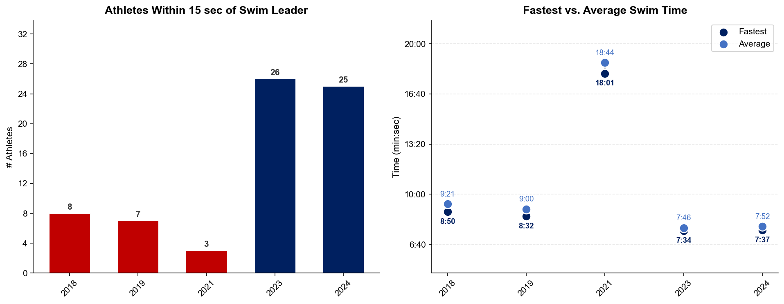
Swim Exit Dynamics — Elite Men
Edmonton

Slide 19
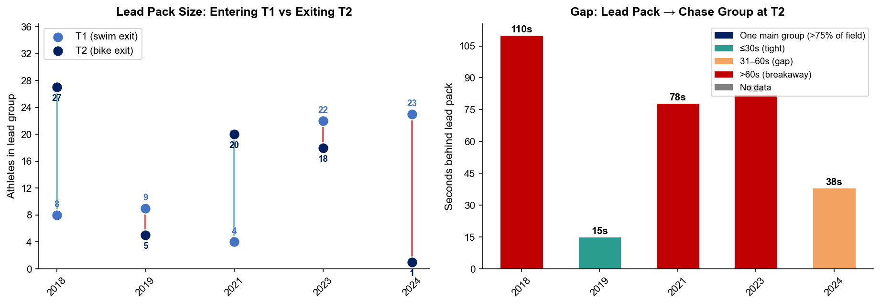
Bike Pack Evolution — Elite Men
Edmonton
Lead pack = athletes within 15 sec of leader. T1 = lead group entering the bike; T2 = lead group exiting the bike.
Year | Lead Size @ T1 | Lead Size @ T2 | Change | Chase Group @ T2 | Chase Gap*
2018 | 8 | 27 | +19 | 19 | 110s
2019 | 9 | 5 | -4 | 22 | 15s
2021 | 4 | 20 | +16 | 10 | 78s
2023 | 22 | 18 | -4 | 8 | 82s
2024 | 23 | 1 | -22 | 12 | 38s
Lead pack = athletes within 15 sec of leader. Chase group = athletes within 15 sec of the first athlete outside the lead pack. * Chase Gap = seconds from the last lead-pack athlete to the first chase-group athlete at T2.
Dropouts: 2018: 9 DNF/LAP (2 in lead group at bike) | 2019: 15 DNF/LAP | 2021: 6 DNF/LAP | 2023: 3 DNF/LAP (1 in lead group at t1)

Slide 20
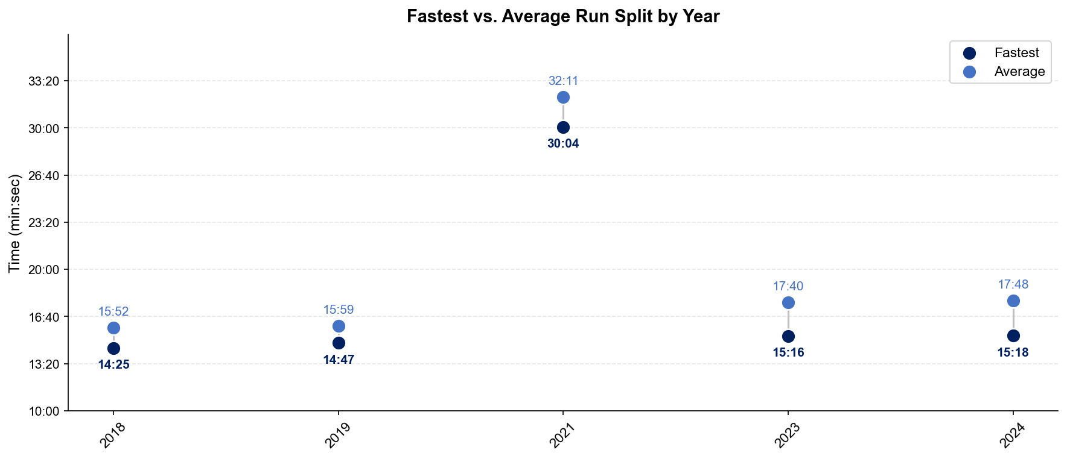
Run Split Analysis — Elite Men
Edmonton

Slide 21
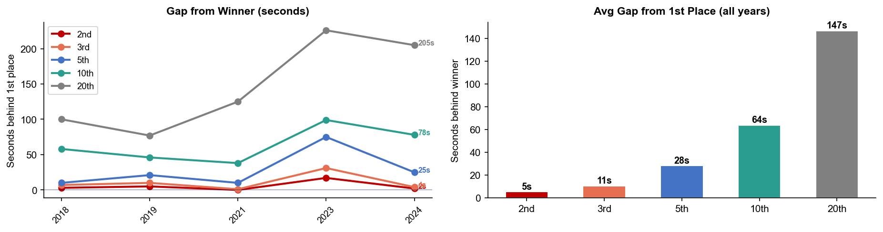
Key Position Times — Elite Men
Edmonton
Year | 1st | 2nd | 3rd | 5th | 10th | 20th
2018 | 51:15 | 51:18 +3s | 51:22 +7s | 51:25 +10s | 52:13 +58s | 52:55 +100s
2019 | 54:52 | 54:57 +5s | 55:02 +10s | 55:13 +21s | 55:38 +46s | 56:09 +77s
2021 | 1:44:14 | 1:44:14 | 1:44:15 +1s | 1:44:24 +10s | 1:44:52 +38s | 1:46:19 +125s
2023 | 49:39 | 49:56 +17s | 50:10 +31s | 50:54 +75s | 51:18 +99s | 53:25 +226s
2024 | 50:06 | 50:08 +2s | 50:10 +4s | 50:31 +25s | 51:24 +78s | 53:31 +205s

Slide 22
Race Conditions — Elite Men
Edmonton
Year | Date | Air Temp | Humidity | Wind (km/h) | Precip (mm) | Water Temp | Wetsuit | Conditions
2018 | Jul 27 | 17.7°* | 69% | 4 | 0.0 | — | — | —
2019 | Jul 20 | 16.0°* | 83% | 10 | 0.0 | — | — | —
2021 | Aug 21 | 12.5°* | 80% | 8 | 0.0 | — | — | —
2023 | Aug 26 | 20 | 82% | 9 | 0.0 | — | — | —
2024 | Aug 24 | 18.2°* | 81% | 20 | 0.1 | — | — | —
Air temp, humidity, wind, and precipitation sourced from Open-Meteo historical archive (race window 08:00–11:00 local) where WT API data is absent. Values marked * are Open-Meteo estimates. Water temp and wetsuit ruling are from the World Triathlon API per program.

Slide 23
ELITE WOMEN

Slide 24
Race Overview — Elite Women
Edmonton
RACE HISTORY AT EDMONTON
3 KEYS TO SUCCESS
The Elite Women race at Edmonton has been held 5 times in this analysis window (2018–2024). The event is staged as part of the World Championship Series / World Championships, World Championship Series calendar. [PLACEHOLDER: Add 1–2 sentences on notable storylines, competitive history, or what makes this event significant for Elite Women athletes. E.g. defending champions, record performances, dramatic finishes.]
1
Fast swimming is decisive — only ~11 athletes typically leave the water together. A strong swim directly builds a race-winning gap before T1.
2
[PLACEHOLDER: Key 2 — Describe bike strategy: is this a pack race or do breakaways form? What power/tactics are needed to stay in the lead group?]
3
Run speed separates the podium — the fastest run pace averages ~2:02/km with a ~131s spread between fastest and average finisher. Either a pre-built lead from the bike or exceptional run speed is required to win.

Slide 25
Results Summary — Elite Women
Edmonton
Year | Date | Category | Field | DNF/LAP/DNS | Winner | Winner Time | Air Temp | Water Temp | Swim km | Bike km | Run km
2018 | Jul 27 | World Championship Series | 55 | 13 | Holland | 56:51 | 17.7°* | — | — | — | —
2019 | Jul 20 | World Championship Series | 41 | 3 | Jackson | 1:01:23 | 16.0°* | — | — | — | —
2021 | Aug 21 | World Championships, World Championship Series | 38 | 5 | Knibb | 1:54:47 | 12.5°* | — | — | — | —
2023 | Aug 26 | Continental Cup * | 25 | 3 | Casas | 56:27 | 20 | — | — | 18.8 | —
2024 | Aug 24 | Continental Cup * | 33 | 3 | Russell | 56:04 | 18.2°* | — | — | 20.0 | —
* Course distance changed vs. prior year

Slide 26
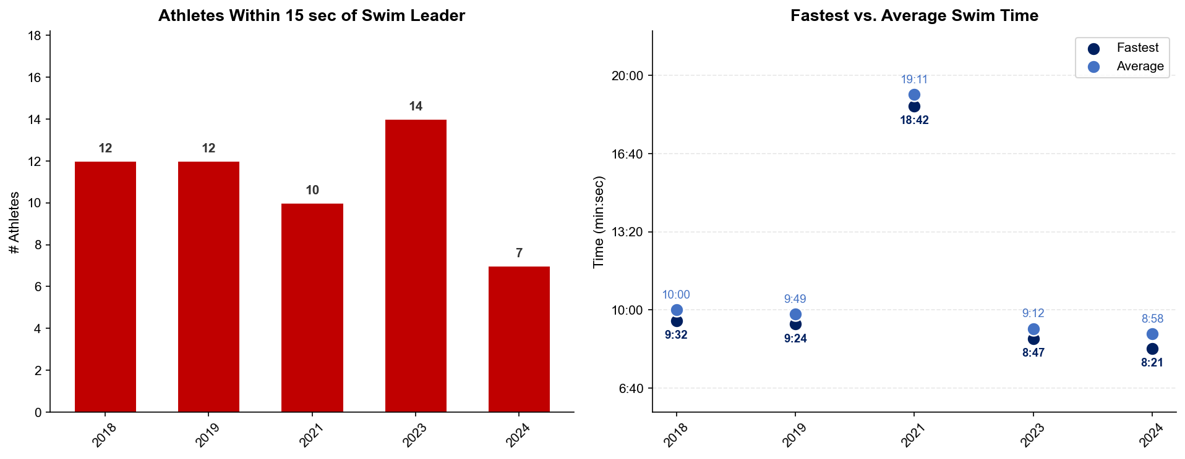
Swim Exit Dynamics — Elite Women
Edmonton

Slide 27
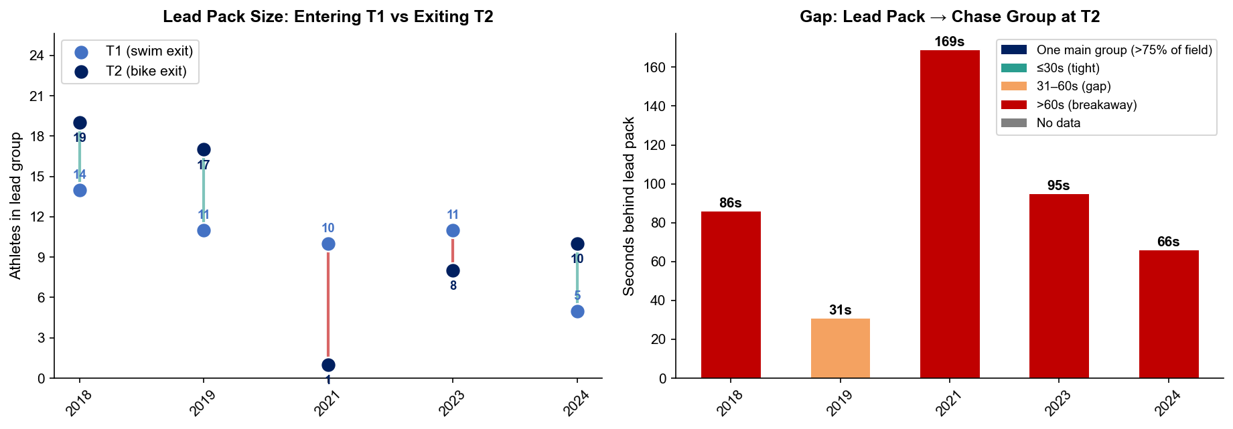
Bike Pack Evolution — Elite Women
Edmonton
Lead pack = athletes within 15 sec of leader. T1 = lead group entering the bike; T2 = lead group exiting the bike.
Year | Lead Size @ T1 | Lead Size @ T2 | Change | Chase Group @ T2 | Chase Gap*
2018 | 14 | 19 | +5 | 6 | 86s
2019 | 11 | 17 | +6 | 11 | 31s
2021 | 10 | 1 | -9 | 10 | 169s
2023 | 11 | 8 | -3 | 3 | 95s
2024 | 5 | 10 | +5 | 11 | 66s
Lead pack = athletes within 15 sec of leader. Chase group = athletes within 15 sec of the first athlete outside the lead pack. * Chase Gap = seconds from the last lead-pack athlete to the first chase-group athlete at T2.
Dropouts: 2018: 13 DNF/LAP (1 in lead group at t1) | 2019: 3 DNF/LAP (1 in lead group at bike) | 2021: 5 DNF/LAP | 2023: 3 DNF/LAP (2 in lead group at swim, t1) | 2024: 1 DNF/LAP

Slide 28
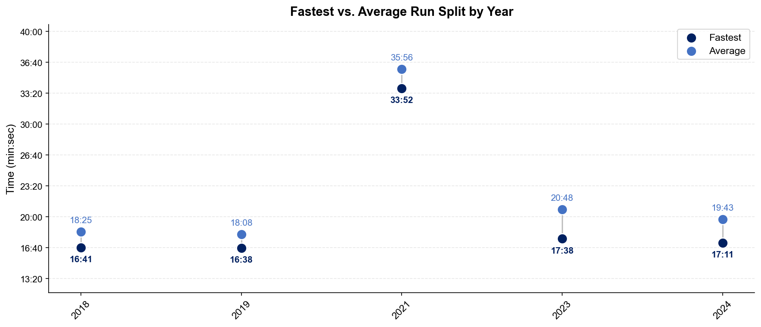
Run Split Analysis — Elite Women
Edmonton

Slide 29
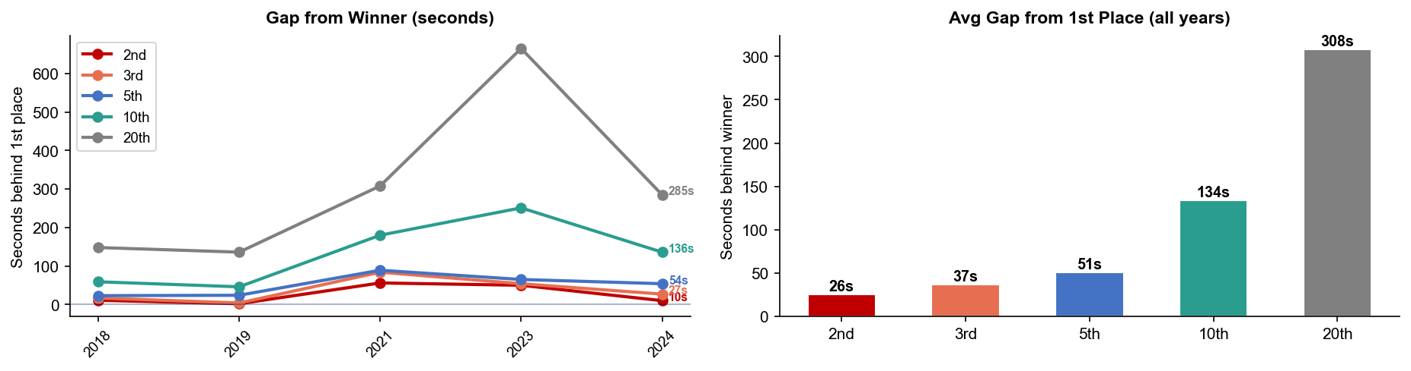
Key Position Times — Elite Women
Edmonton
Year | 1st | 2nd | 3rd | 5th | 10th | 20th
2018 | 56:51 | 57:02 +11s | 57:08 +17s | 57:14 +23s | 57:50 +59s | 59:19 +148s
2019 | 1:01:23 | 1:01:25 +2s | 1:01:27 +4s | 1:01:47 +24s | 1:02:09 +46s | 1:03:39 +136s
2021 | 1:54:47 | 1:55:43 +56s | 1:56:11 +84s | 1:56:16 +89s | 1:57:47 +180s | 1:59:55 +308s
2023 | 56:27 | 57:17 +50s | 57:21 +54s | 57:32 +65s | 1:00:38 +251s | 1:07:32 +665s
2024 | 56:04 | 56:14 +10s | 56:31 +27s | 56:58 +54s | 58:20 +136s | 1:00:49 +285s

Slide 30
Race Conditions — Elite Women
Edmonton
Year | Date | Air Temp | Humidity | Wind (km/h) | Precip (mm) | Water Temp | Wetsuit | Conditions
2018 | Jul 27 | 17.7°* | 69% | 4 | 0.0 | — | — | —
2019 | Jul 20 | 16.0°* | 83% | 10 | 0.0 | — | — | —
2021 | Aug 21 | 12.5°* | 80% | 8 | 0.0 | — | — | —
2023 | Aug 26 | 20 | 82% | 9 | 0.0 | — | — | —
2024 | Aug 24 | 18.2°* | 81% | 20 | 0.1 | — | — | —
Air temp, humidity, wind, and precipitation sourced from Open-Meteo historical archive (race window 08:00–11:00 local) where WT API data is absent. Values marked * are Open-Meteo estimates. Water temp and wetsuit ruling are from the World Triathlon API per program.

